Slide 1

Physics ICT
Done by: Sara , Elham , Salma.K

Slide 2

My ICTproduct explains the topic “Work and Energy”
It is a website that I've programmed in Visual studio code using HTML programming language
The website has a simple explanation of the topic in the beginning , it includes images, a video, and a quizzes game which makes it interactive
The website has no technical problems or errors and is simple and easy to use

Slide 3
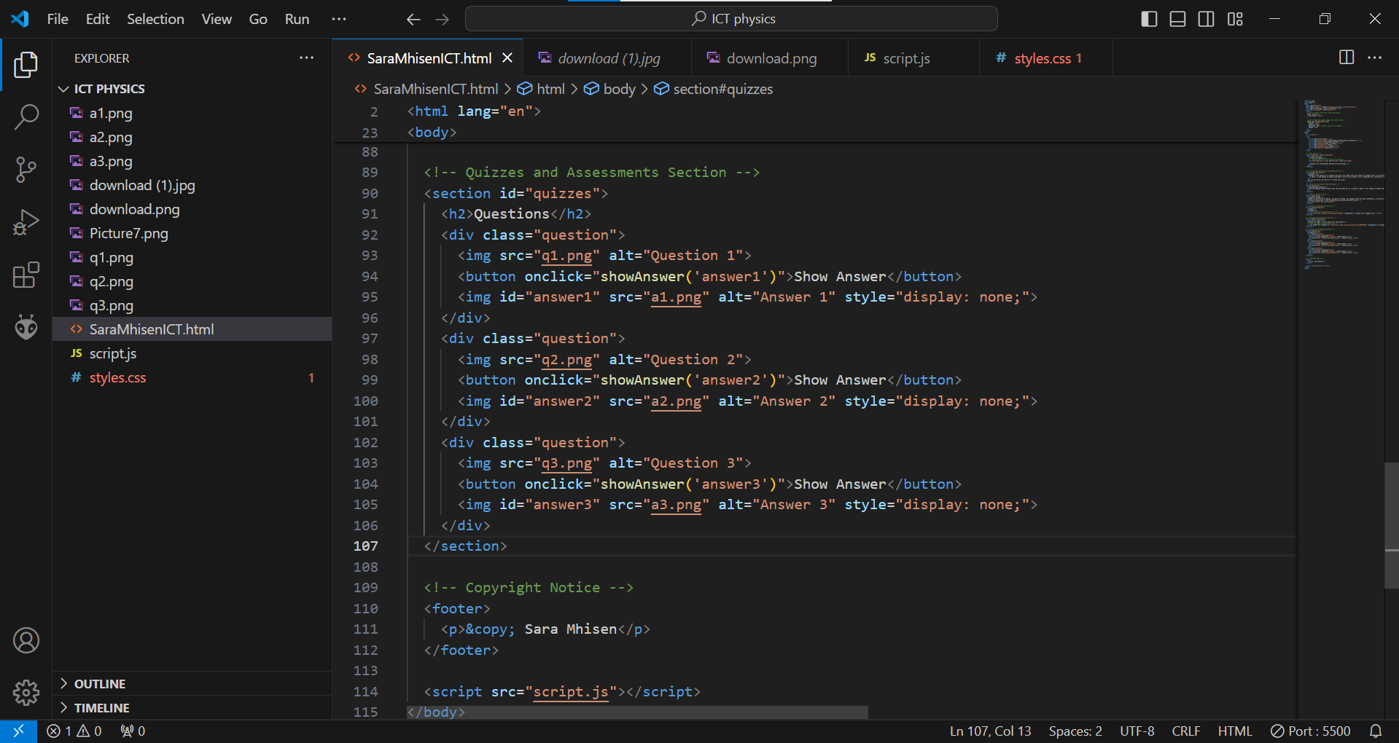
Programming using VSC

Slide 4
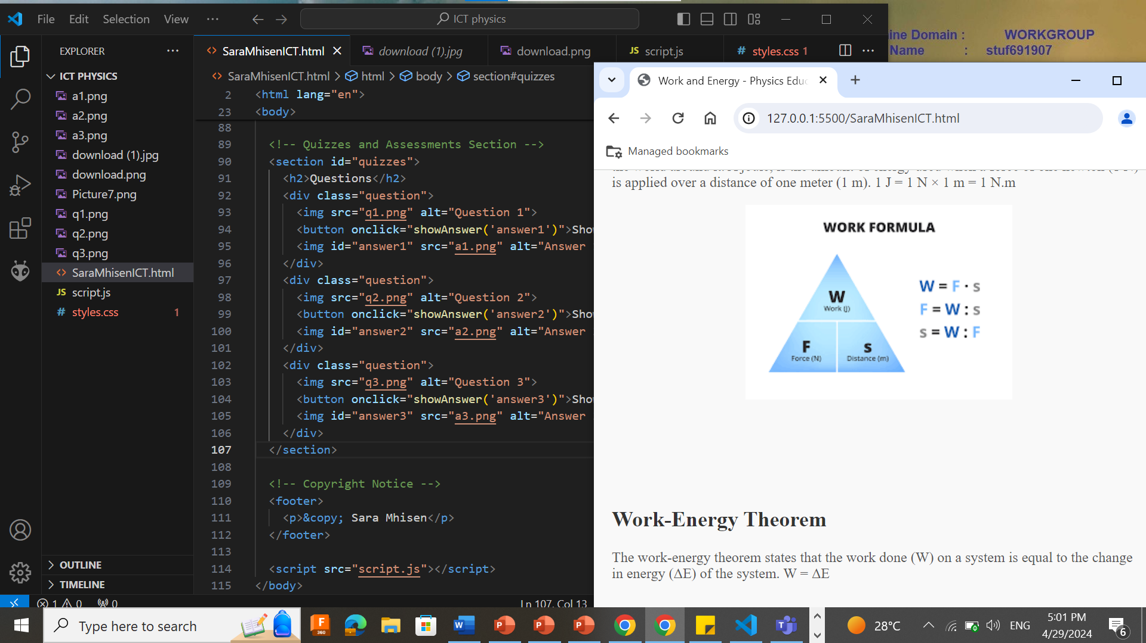

Slide 5

The website link
http://127.0.0.1:5500/SaraMhisenICT.html
Or Click Here

